Slide 1
What Impacts will Gender Stereotypes Have on Children?
Presented by Zhongheng Yang, Kaiqi Wang

Slide 2
Question
High-level cognitive ability is presented more often in men than in women.
However, little is known about the acquisition of this stereotype.
brilliance
males

Slide 3
Data
Four studies:
N = 400 children, mostly from a middle-class, majority-white U.S.
 | Study 1 | Study 2 | Study 3 | Study 4
Question | Assess children’s endorsement of the “brilliant = male” stereotype. | What might explain the drop in girls’ evaluation of their gender’s intellectual abilities? | Will children’s gendered beliefs about brilliance shape their interests? | Will aged-5 boys’ and girls’ interest in these games would not differ because their ideas about brilliance are not yet differentiated?
Comparison | Aged 5 vs 6 vs 7 between boys and girls. | Younger(5) and older (6 or 7) girls in their perceptions of their school achievement. | Aged 6 and 7 were introduced into 2 games, one said to be for “smart children”, the other for “children who try really, really hard.” | 5- and 6-year-old boys’ and girls’ interest in novel games said to be “for children who are really, really smart”

Slide 4
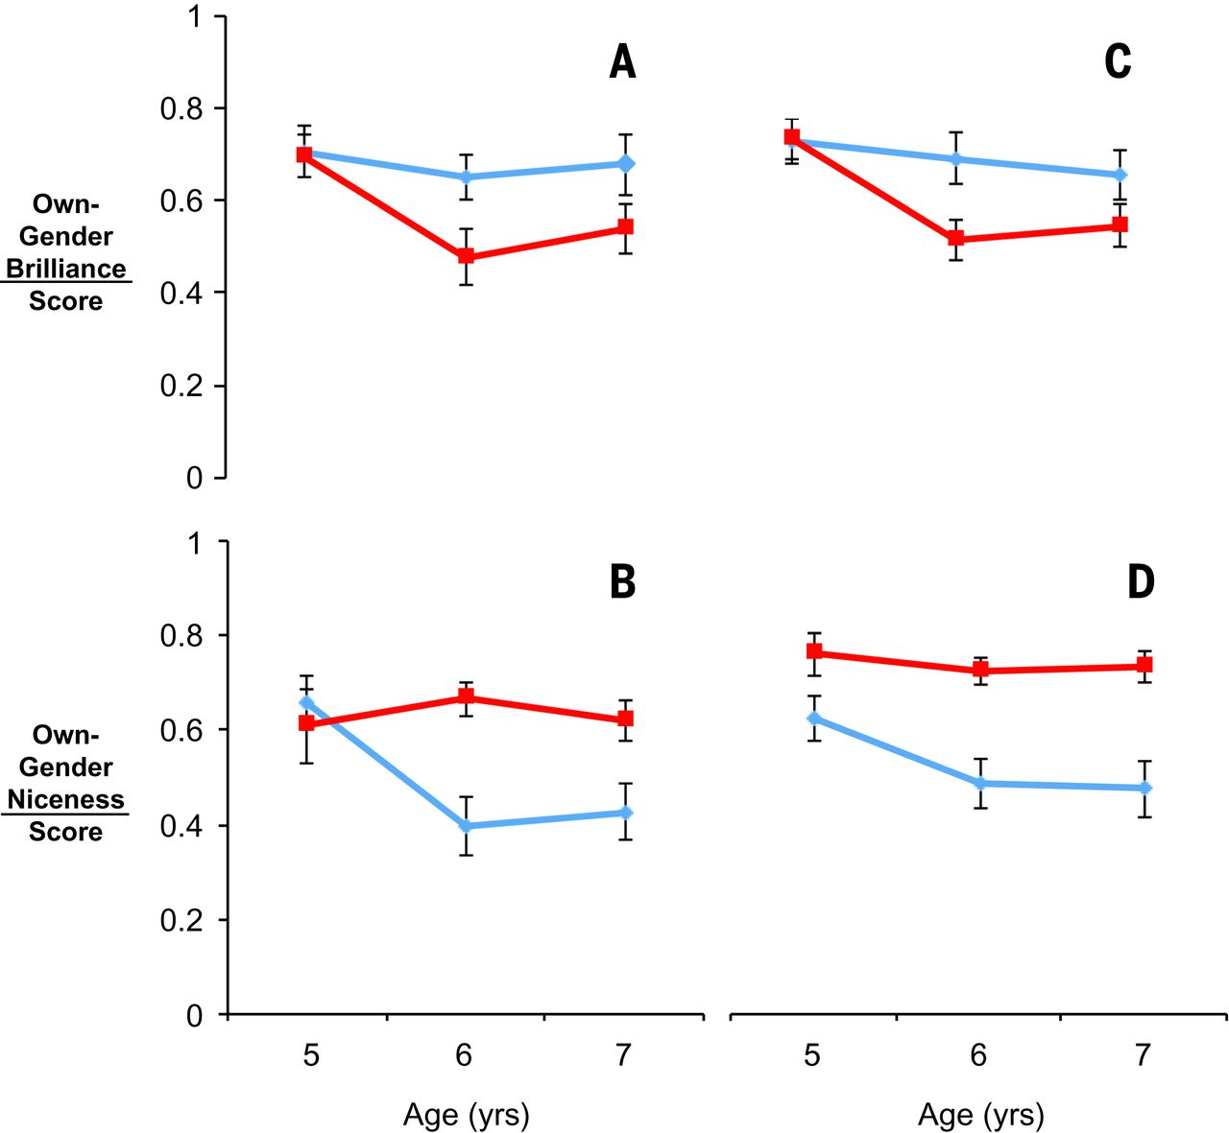
Results of Study 1
Boys
Girls
Finding: 6-year-old children approve of “brilliance = males” stereotype.

Slide 5
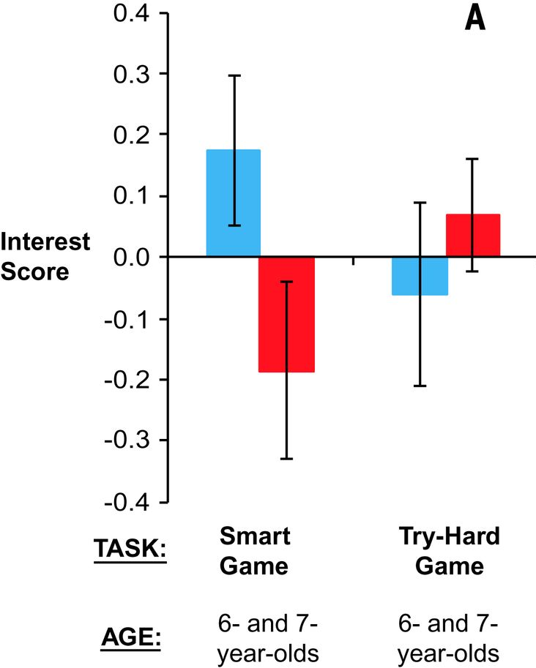
Results of Study 3
Boys
Girls
Finding: Girls were less interested than boys in the game for smart children.

Slide 6
Summary
By the age of 6, girls are less likely than boys to believe that members of their gender are “really, really smart”.
Also at 6, girls begin to avoid activities said to be for children who are “really, really smart”.

Slide 7
Answer
Many children approve of the idea that brilliance is a male quality at a young age.
This stereotype begins to shape children’s interests as soon as it is acquired.
Thus, it is likely to narrow the range of careers they will one day contemplate.

Slide 8
What can we do?
For individual:
Keep confident.
Follow your heart, not others.
For society:
Keep everyone equal.
Attribute one’s brilliance to his efforts and willpower, instead of gender.
brilliance
males
brilliance
efforts

Slide 9
Thank you for listening

